Slide 1

Role and importance of communication
Dr.T. SUNAND EMMANUEL
CSE-A
Academic year 2021-22

Slide 2
Definition of communication
Communication is derived from the latin word ‘communis’ which means ‘to share’.
So, communication may be defined as sharing information and ideas so as to create mutual understanding between people.
Mutual understanding is the most important feature of communication.

Slide 3
It is the process by which information and feelings are shared by people through an exchange of verbal and non-verbal messages.
Verbal---It includes writing or speaking using words
Non-verbal---It is communication without using words. (smile, touch, eye contact, sitting posture, posture)

Slide 4
William Newman and Charles Summer: Communication is an exchange of ideas, facts, opinions or emotions of two or more persons.
D.E. Mc Farland: It is a process of meaningful interaction among human beings. It is a purposeful exchange of facts, ideas, opinions, emotions, and information that leads to a common understanding.

Slide 5
Functions of Communication
To build a strong social environment: Our social environment is framed, designed, and built according to our needs and conveniences. So, we need to communicate to maintain this social environment.
Global village:The world is a global village today.We have so many conflicts. Another function of communication is to build a global village of peace and understanding among nations, races, and peoples.
Sharing ideas:We share our ideas, feelings, opinions, and thoughts with others to satisfy our needs.

Slide 6


Slide 7


Slide 8


Slide 9
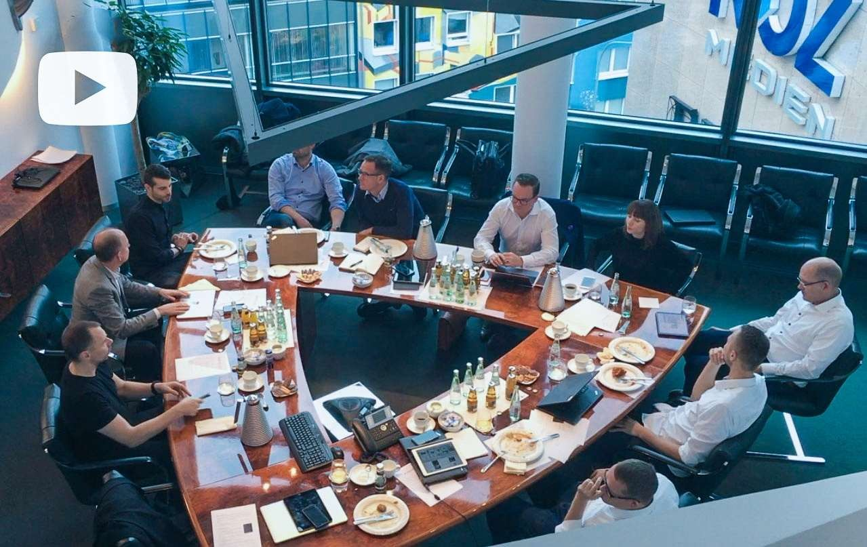

Slide 10
Sharing Knowledge: Man invents, discovers, innovates, creates, develops constantly. He must share all these things with other scientists and the world only through communicating.
Planning: All management functions are designed on the foundation of planning. Rules, regulations, policies are discussed and planned well. This needs good C.
Decision making:Timely and suitable decisions are most critical for an organisation. So, C is essential for employers and employees

Slide 11


Slide 12
Coordination: All departments have to communicate with one another daily for the smooth functioning of the organisation.
Motivation: Another function of communication is where managers need to motivate employees perform better in their jobs.They need to encourage them positively!

Slide 13
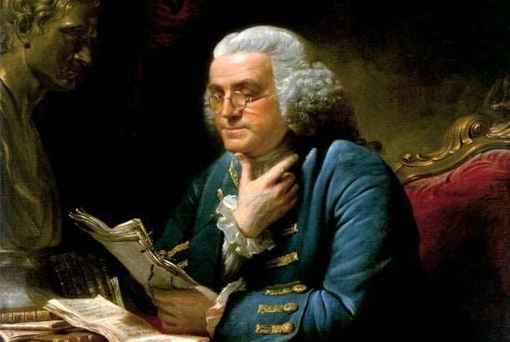

Slide 14
9. Control: Control does not mean commanding or threatening. It means ensuring that all things go smoothly. What are the areas to improve further? What else must be done to help employees work better? So, assessment, feedback, and correcting them are crucial. Employees are made aware of their duties and responsibilities.

Slide 15
Interpersonal relations: Another function of communication is maintaining and strengthening good interpersonal relations between employers and employees.
Resolving conflicts: One more function of communication is resolving conflicts. Differences of communication are normal between people. So, resolving is very important. Hence, communication is the tool to resolve conflicts among employees.

Slide 16


Slide 17
12. Informing: The principal function of communication is informing messages to others. It really is done verbally or non-verbally. Verbal messages might be either oral or written. On the other hand, non-verbal messages can be sent via human body language, gestures, posture, eye contact, etc.

Slide 18
Features of communication
Central to everything we do.
Vital for our own and an organisation’s survival and growth.
It is dynamic and active process. (Our opinions keep changing, relationships keep changes, ideas keep changing!).
Minimum of 2 people

Slide 19
It is a goal-oriented process.
It is a social process.
Man does not live in isolation. He builds his social relations with his fellow human beings.

Slide 20
Communication in organisations
Organisations need to communicate internally with its employees, management members for smooth functions.
Externally, companies need to communicate with shareholders, governments, local agencies, banks, customers, suppliers, manufacturers.
Organisations must communicate effectively and efficiently every day internally and externally.

Slide 21
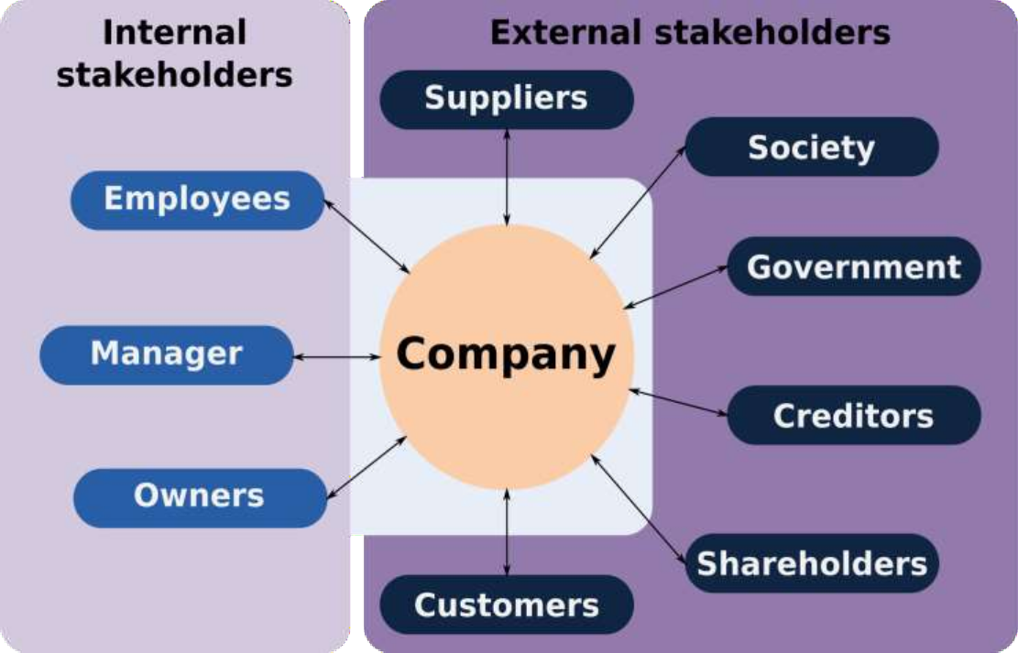
Importance of communication

Slide 22
Elements of Communication
Sender—The person who is speaking
Ideas (Sender has some ideas to convey)
Encoding (He chooses words)
Message (What sender wishes to say, express, inform)
Channels (phone, whatsapp, voice call, letters,)
Receiver
Decoding (Trying to understand what sender said)
Feedback (Receiver tells sender how much he understood)
Noise– Anything that disrupts communication (loud noise, phone sounds, strong opinions, hatred, etc.)

Slide 23
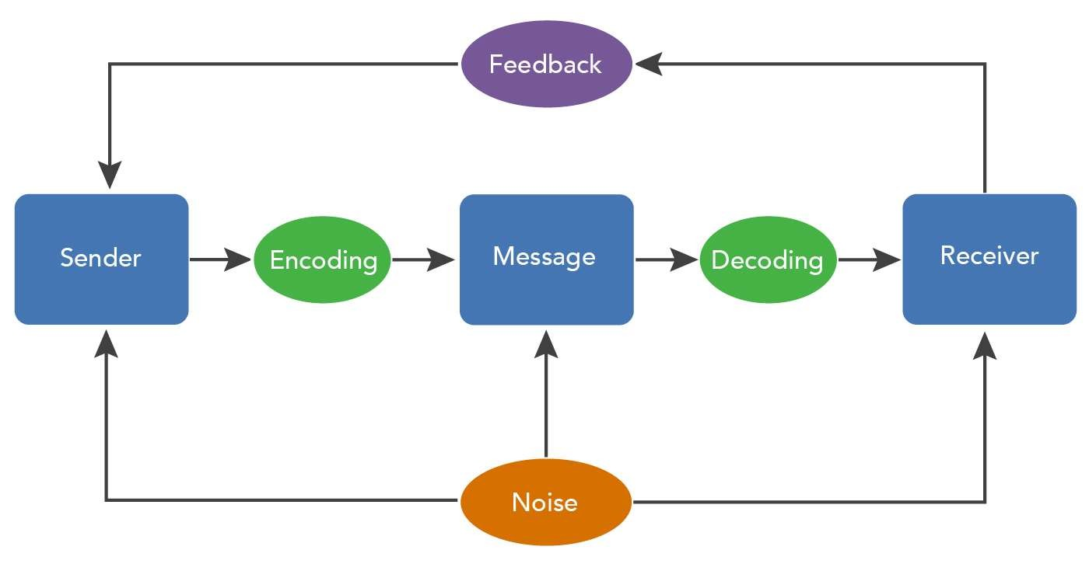
Process of communication

Slide 24
This PPT is dedicated to my teachers......
Prof. Mark L. Knapp
Prof. Brian H. Spitzberg
Prof. Joseph A. DeVito

Slide 25
Thank you

